Slide 1

Name : Priyanka Zala
Role : Data Analyst

Slide 2
Question 1:
1. Daily Active Users: Total number of users who were active (triggered an event) on a
given day
select date ,count(distinct user_id) as total_active_users
from Activity
group by date
order by date;
2. Weekly Active Users: Total number of users who were active (triggered an event) in a
given week
select extract(week from date) ,count(distinct user_id) as total_active_weekly_users
from Activity
group by 1
order by 1

Slide 3
3. Same-day Purchasers: Total number of users who have made a purchase on the same
day they opened the app for the first time
select a1.date as Date,
Count(distinct a.user_id) as same_day_puchase
from activity a1
inner join activity a2
on a1.user_id=a2.user_id
where a1.event_name='in_app_purchase'
and a2.event_name='first_open'
and a1.date=a2.date
group by 1
order by 1

Slide 4
4. Percentage of paid-users in each country: Distribution of paid users according to the
country they belong to, where country must be classified as “India”,”United States” and if
the country is anything besides these two countries it must belong to “Others”
select
case
when country='India' then 'India'
when country='United States' then 'United States'
else 'Other'
end as country,
CONCAT(ROUND((count(distinct
case when event_name'in_app_purchase' then user_id
End)
/
count(distinct user_id)
)*100),%)
as 'Percentage'
from activity
group by 1

Slide 5
5. Day 1 Retention: Among all the users who installed and opened the app on a given day,
how many came back to the app on the next day
select a1.date as Date,
count(distinct a1.user_id) as 'D0 Users'
concat(round((count(distinct case
when a2.date=DATE_ADD(a1.date , INTERVAL 1 DAY) then a2.user_id
END)
/
count(distinct a1.user_id))*100),%) as 'D1%'
from Activity a1
left join Activity a2
on a1.user_id=a2.user_id
group by 1
order by 1

Slide 6
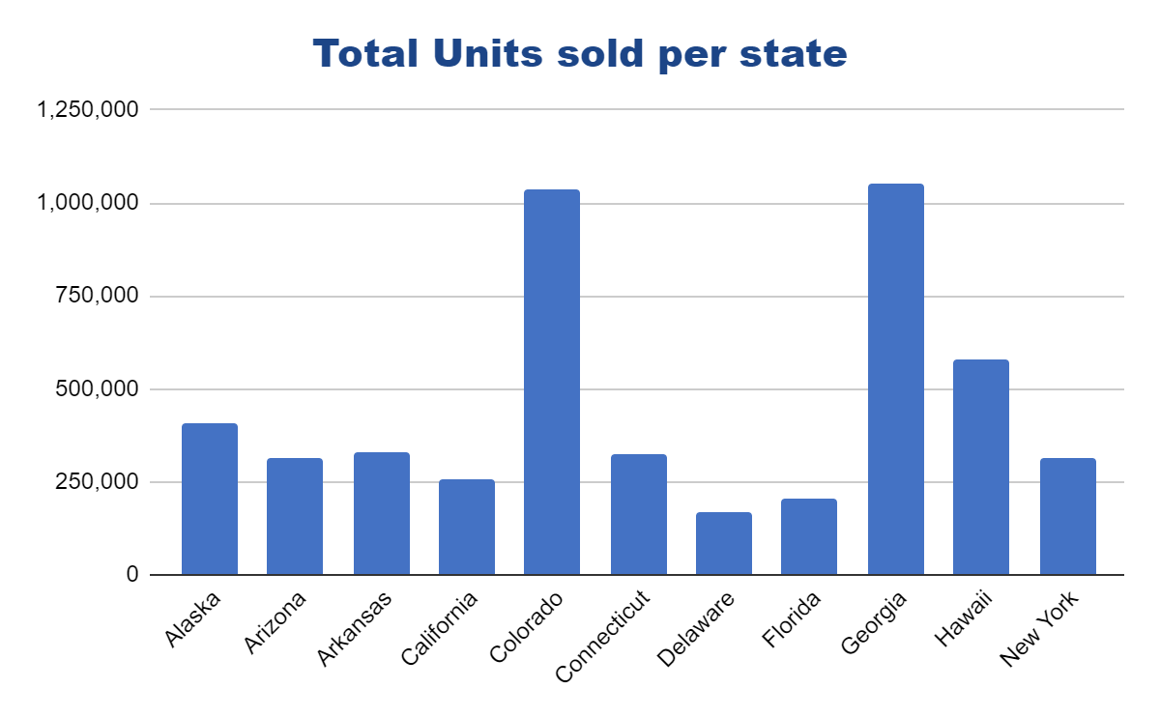
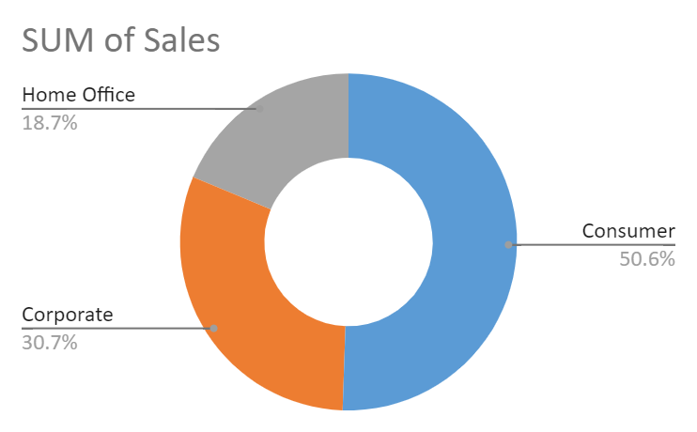
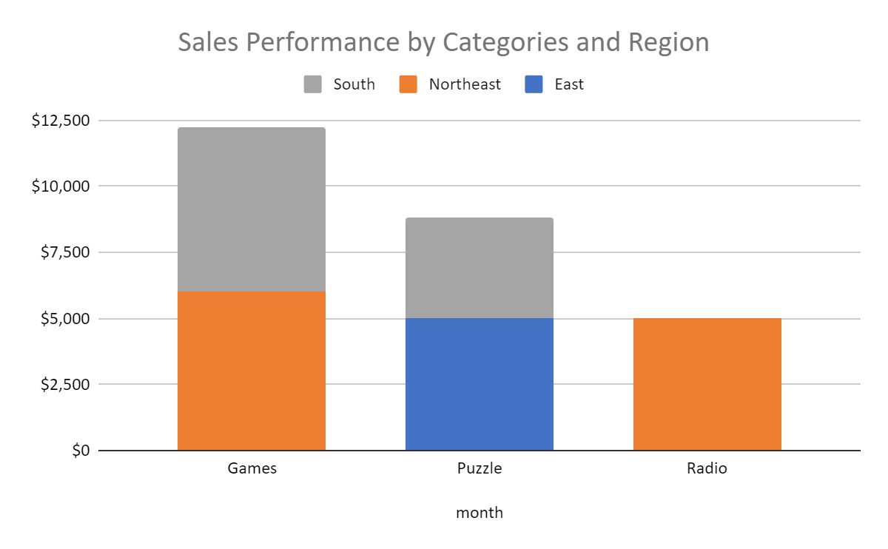
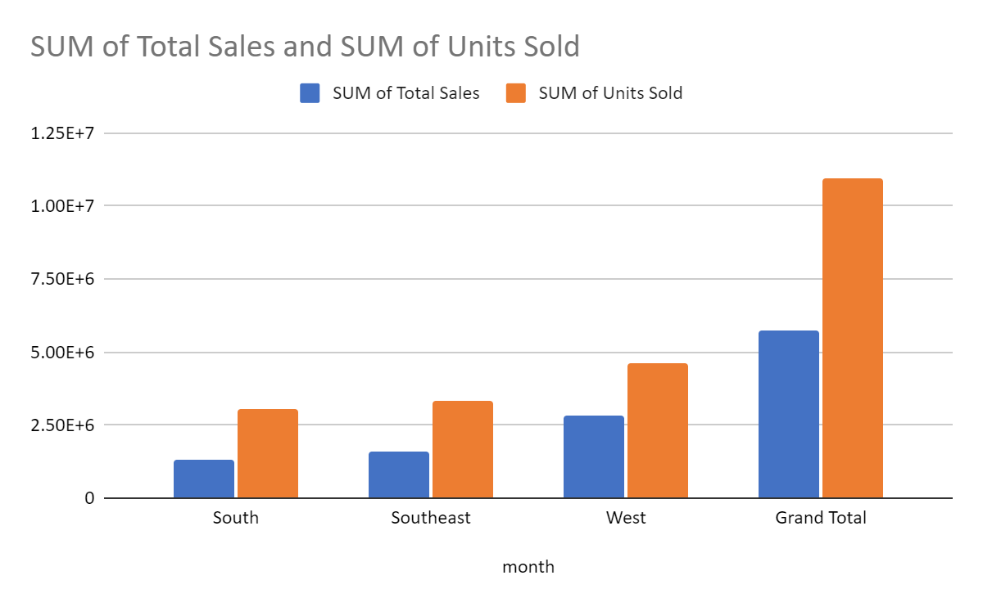
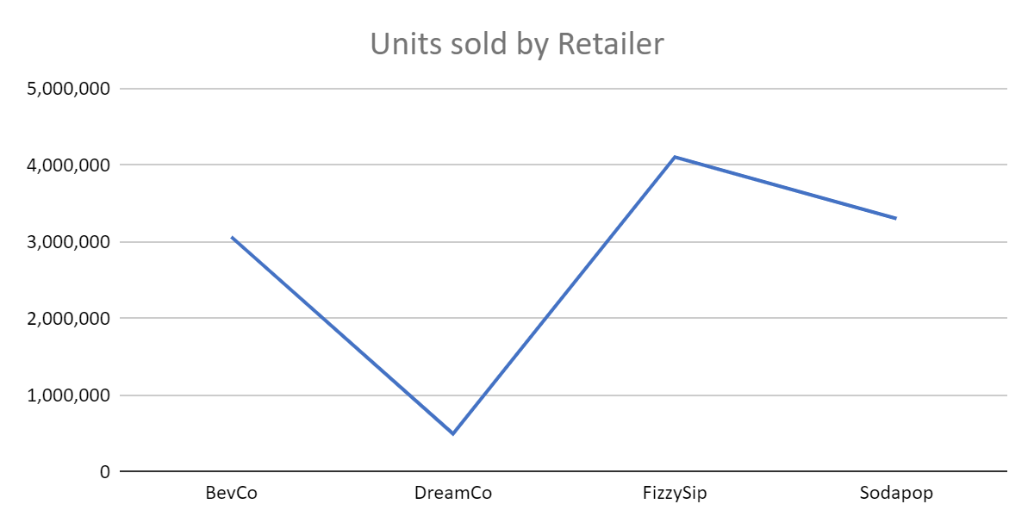
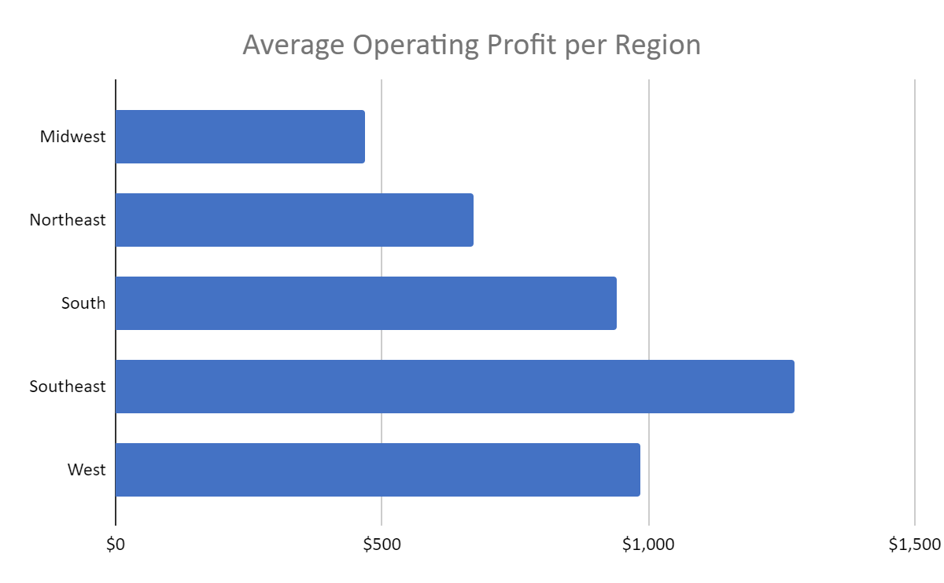
Total Sales
$8,684,028
Total Units Sold
$17,148,250
Total Operating Profit
$3,173,632
Average Operating Profit
36 %

